Slide 1
Distributed Mutual Exclusion
Dr. Barsha Mitra
CSIS Dept, BITS Pilani, Hyderabad Campus

Slide 2
Types of Approaches
Token-based
Assertion-based
From Recorded Lecture
Quorum-based

Slide 3
Quorum-Based Approach
each site requests permission to execute the CS from a subset of sites called quorum
quorums are formed in such a way that when two sites concurrently request access to the CS
at least one site receives both the requests
this site is responsible to make sure that only one request executes the CS at any time

Slide 4
Requirements of Mutual Exclusion Algorithms
Safety property
at any instant, only one process can execute the CS
Liveness property
a site must not wait indefinitely to execute the CS while other sites are repeatedly executing the CS
Fairness
each process gets a fair chance to execute the CS
CS execution requests are executed in order of their arrival time
time is determined by a logical clock

Slide 5
Performance Metrics
From Recorded Lecture

Slide 6
Lamport’s Algorithm
every site S_{i} keeps a queue, request_queue_{i}
request_queue_{i} contains mutual exclusion requests ordered by their timestamps
FIFO
CS requests are executed in increasing order of timestamps

Slide 7
Lamport’s Algorithm
Requesting the critical section:
• When a site S_{i} wants to enter the CS, it broadcasts a REQUEST(ts_{i}, i) message to all other sites and places the request on request_queue_{i}. ((ts_{i}, i) denotes the timestamp of the request)
• When a site S_{j} receives the REQUEST(ts_{i}, i) message from site S_{i}, it places site S_{i}’s request on request_queue_{j} and returns a timestamped REPLY message to S_{i}

Slide 8
Lamport’s Algorithm
Executing the critical section:
Site S_{i} enters the CS when the following two conditions hold:
L1: S_{i} has received a message with timestamp larger than (ts_{i}, i) from all other sites
L2: S_{i}’s request is at the top of request_queue_{i}
Releasing the critical section:
• Site S_{i}, upon exiting the CS, removes its request from the top of its request queue and broadcasts a timestamped RELEASE message to all other sites
• When a site S_{j} receives a RELEASE message from site S_{i}, it removes S_{i}’s
request from its request queue

Slide 9
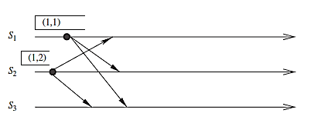
Lamport’s Algorithm
Sites S₁ and S₂ make requests for the CS

Slide 10
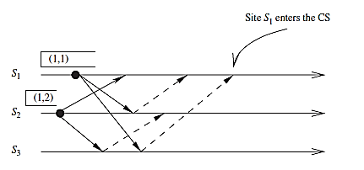


Lamport’s Algorithm
REPLY
May also write as: request_queue₁ = ((1, 1), (1, 2))
REQUEST
Site S₁ enters the CS

Slide 11
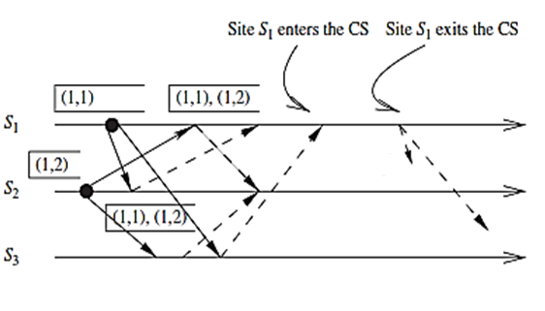
Lamport’s Algorithm
RELEASE
Site S₁ exits the CS and sends RELEASE messages

Slide 12
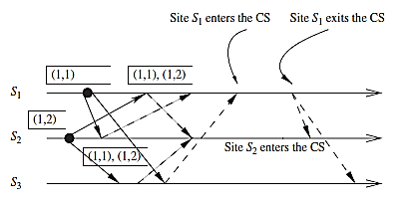

Lamport’s Algorithm
Site S₂ enters the CS
Performance - Requires 3(N − 1) messages per CS invocation

Slide 13
Ricart–Agrawala Algorithm
communication channels are not required to be FIFO
REQUEST and REPLY messages
each process p_{i} maintains the request-deferred array, RD_{i}
size of RD_{i} = no. of processes in the system
initially, ∀i ∀j: RD_{i}[j] = 0
whenever p_{i} defers the request sent by p_{j}, it sets RD_{i}[j] = 1,
after it has sent a REPLY message to p_{j} , it sets RD_{i}[j] = 0

Slide 14
Ricart–Agrawala Algorithm
Requesting the critical section:
When a site S_{i} wants to enter the CS, it broadcasts a timestamped REQUEST message to all other sites
(b) When site S_{j} receives a REQUEST message from site S_{i}, it sends a REPLY message to site S_{i} if site S_{j} is neither requesting nor executing the CS, or if the site S_{j} is requesting and S_{i}’s request’s timestamp is smaller than site S_{j}’s own request’s timestamp. Otherwise, the reply is deferred and S_{j} sets RD_{j} [i] = 1

Slide 15
Ricart–Agrawala Algorithm
Executing the critical section:
(c) Site S_{i} enters the CS after it has received a REPLY message from every site it sent a REQUEST message to
Releasing the critical section:
(d) When site S_{i} exits the CS, it sends all the deferred REPLY messages:
∀j if RD_{i} [j] = 1, then S_{i} sends a REPLY message to S_{j} and sets RD_{i} [j] = 0

Slide 16
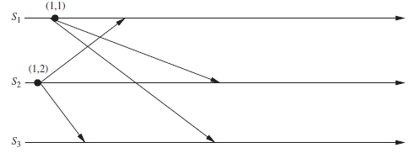
Ricart–Agrawala Algorithm
Sites S₁ and S₂ each make a request for the CS

Slide 17
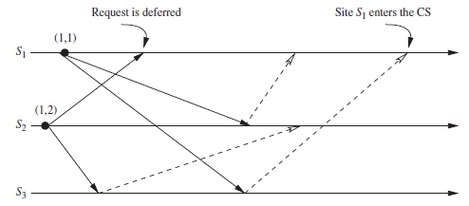
Ricart–Agrawala Algorithm
Site S₁ enters the CS

Slide 18
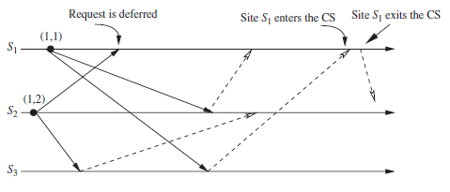
Ricart–Agrawala Algorithm
Site S₁ exits the CS and sends a REPLY message to S₂’s deferred request

Slide 19
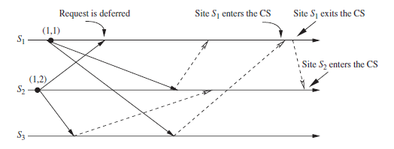
Ricart–Agrawala Algorithm
Site S₂ enters the CS
Performance - requires 2(N − 1) messages per CS execution

Slide 20
Maekawa’s Algorithm
quorum-based mutual exclusion algorithm
request sets for sites (i.e., quorums) are constructed to satisfy the following conditions:
M1: (∀i ∀j : i ≠ j, 1 ≤ i, j ≤ N :: R_{i} ∩ R_{j} ≠ φ )
M2: (∀i : 1 ≤ i ≤ N :: S_{i} ∈ R_{i})
M3: (∀i : 1 ≤ i ≤ N :: |R_{i}| = K for some K)
M4: Any site S_{j} is contained in K number of R_{i}’s, 1 ≤ i, j ≤ N
Maekawa showed that N = K(K − 1) + 1
This relation gives |R_{i}| = K = √N (square root of N)
Uses REQUEST, REPLY and RELEASE messages
Performance → 3√N messages per CS invocation

Slide 21
Maekawa’s Algorithm: Problem

Slide 22
Maekawa’s Algorithm
Algorithm Steps: from Recorded Lecture
Deadlocks: from Recorded Lecture

Slide 23
Raymond’s Tree-Based Algorithm
uses a spanning tree of the network
each node maintains a HOLDER variable that provides information about the placement of the privilege in relation to the node itself
a node stores in its HOLDER variable the identity of a node that it thinks has the privilege or leads to the node having the privilege
for 2 nodes X and Y, if HOLDER_{X} = Y, the undirected edge between X and Y can be redrawn as a directed edge from X to Y
Node containing the privilege is also known as the root node

Slide 24
Raymond’s Tree-Based Algorithm
messages between nodes traverse along undirected edges of the tree
node needs to hold information about and communicate only to its immediate-neighboring nodes
HOLDER_{N1} = N2
HOLDER_{N2} = N3
HOLDER_{N3} = self
HOLDER_{N4} = N3
HOLDER_{N5} = N4
HOLDER_{N6} = N5
HOLDER_{N7} = N5
HOLDER_{N8} = N6
HOLDER_{N9} = N6
N1
N2
N3
N4
N9
N6
N5
N8
N7

Slide 25
Raymond’s Tree-Based Algorithm
N1
N2
N3
N4
N1
N2
N3
N4
N9
N6
N5
N9
N6
N5
N8
N7
N8
N7

Slide 26
Raymond’s Tree-Based Algorithm
Data Structures
HOLDER
USING
possible values true or false
indicates if the current node is executing the critical section
ASKED
possible values true or false
indicates if node has sent a request for the privilege
prevents the sending of duplicate requests for privilege

Slide 27
Raymond’s Tree-Based Algorithm
Data Structures
REQUEST_Q
FIFO queue that can contain “self ” or the identities of immediate neighbors as elements
REQUEST_Q of a node consists of the identities of those immediate neighbors that have requested for privilege but have not yet been sent the privilege
maximum size of REQUEST_Q of a node is the number of immediate neighbors + 1 (for “self ”)

Slide 28
Suzuki–Kasami’s Broadcast Algorithm
broadcasts a REQUEST message for the token to all other sites
site that possesses the token sends it to the requesting site upon the receipt of its REQUEST message
if a site receives a REQUEST message when it is executing the CS, it sends the token only after it has completed the CS execution

Slide 29
Suzuki–Kasami’s Broadcast Algorithm
Distinguish outdated and current REQUEST messages
REQUEST(j, sn) where sn (sn = 1, 2…..) is a sequence number that indicates that S_{j} is requesting its sn^{th} CS execution
S_{i} keeps an array of integers RN_{i}[1, … ,n] where RN_{i}[j] is the largest sequence number received in a REQUEST message so far from S_{j}
when S_{i} receives a REQUEST(j, sn) message, it sets RN_{i}[j] = max(RN_{i}[j], sn)
when S_{i} receives a REQUEST(j,sn) message, the request is outdated if RN_{i}[j] > sn

Slide 30
Suzuki–Kasami’s Broadcast Algorithm
sites with outstanding requests for the CS are determined in the following manner:
token consists of a queue of requesting sites, Q, and an array of integers LN[1, … ,n], where LN[j] is the sequence number of the request which S_{j} executed most recently
after executing its CS, a S_{i} updates LN[i] = RN_{i}[i]
token array LN[1, … ,n] permits a site to determine if a site has an outstanding request for the CS
at S_{i}, if RN_{i}[j] = LN[j] + 1, then S_{j} is currently requesting a token
after executing the CS, a site checks this condition for all the j’s to determine all the sites that are requesting the token and places their i.d.’s in queue Q if these i.d.’s are not already present in Q
finally, the site sends the token to the site whose i.d. is at the head of Q

Slide 31
Suzuki–Kasami’s Broadcast Algorithm
Requesting the critical section:
(a) If requesting site S_{i} does not have the token, then it increments its sequence number, RN_{i}[i], and sends a REQUEST(i, sn) message to all other sites. (“sn” is the updated value of RN_{i}[i].)
(b) When a site S_{j} receives this message, it sets RN_{j}[i] to max(RN_{j}[i], sn). If S_{j} has the idle token, then it sends the token to S_{i} if RN_{j}[i] = LN[i]+1.
Executing the critical section:
(c) Site S_{i} executes the CS after it has received the token.

Slide 32
Suzuki–Kasami’s Broadcast Algorithm
Releasing the critical section: Having finished the execution of the CS, site S_{i} takes the following actions:
(d) It sets LN[i] element of the token array equal to RN_{i}[i].
(e) For every site S_{j} whose i.d. is not in the token queue, it appends its i.d. to the token queue if RN_{i}[j] = LN[j] + 1.
(f) If the token queue is non-empty after the above update, S_{i} deletes the top site i.d. from the token queue and sends the token to the site indicated by the i.d.

Slide 33
Suzuki–Kasami’s Broadcast Algorithm
Performance
if a site holds the token, no message is required
if a site does not hold the token, N messages are required

Slide 34
Reference
Ajay D. Kshemkalyani, and Mukesh Singhal, Chapter 9, “Distributed Computing: Principles, Algorithms, and Systems”, Cambridge University Press, 2008.

Slide 35
Thank You

